Slide 1

02
Time Series Forecasting
Let’s do some Forecasting!
Current Objective:
Membangun model Peramalan
Seri Waktu Harga Bitcoin

Slide 2
Prapemrosesan Data Deret Waktu
01
02
03
Outlier Detection
Outlier Handling
Isolation Forest
Simple Moving Average
04
Stationary Test
Transformation
Augmented Dickey-Fuller Test
Differencing Transformation

Slide 3
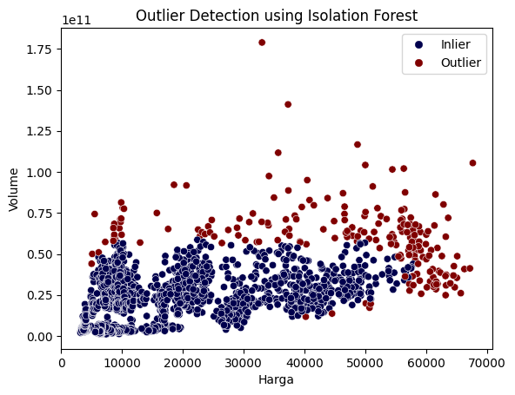
Outlier Detection dan Handling
Terdapat 204 outlier!

Slide 4
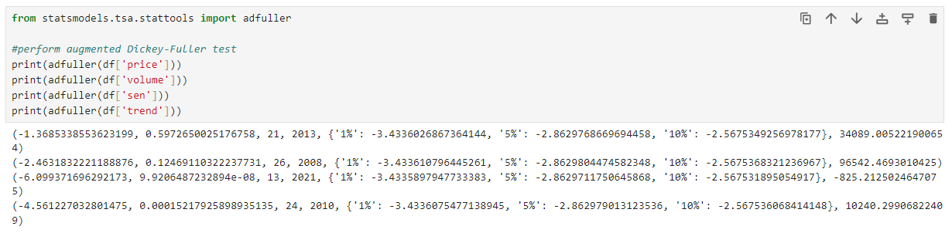
Stationary Test

Slide 5
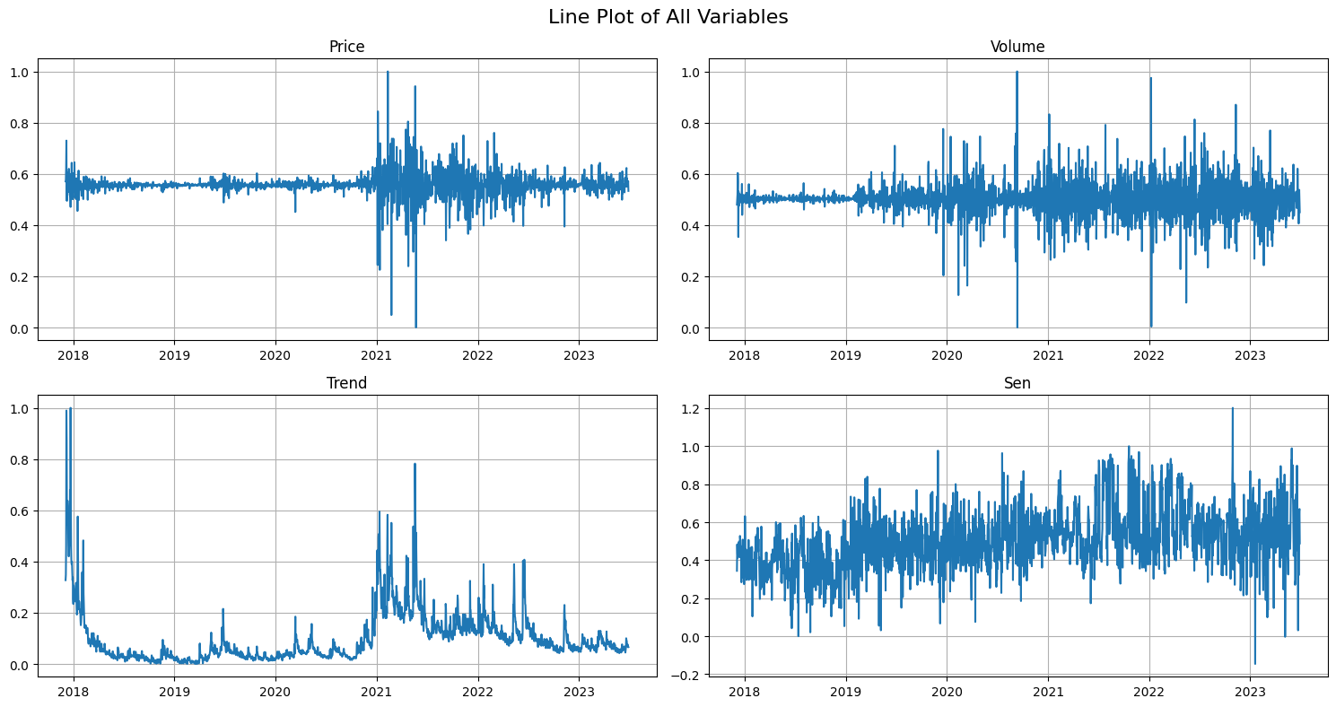
Differencing Transformation The First Order! With some Spice

Slide 6
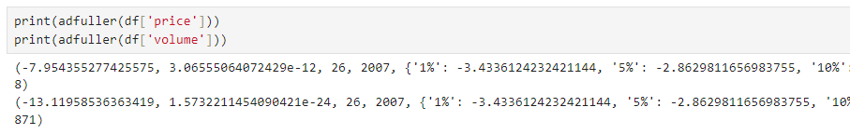
Stationary Test

Slide 7
FORECASTING!

Slide 8
Model Peramalan Seri Waktu Harga Bitcoin
 | Temporal Fusion Transformer |  |  | Long-Short Term Memory
Included Covariate | RMSE | sMAPE | MAPE | RMSE | sMAPE | MAPE
Trend, Sentiment, and Volume | 0,0260 | 3,0199 | 3,0499 | 0,0263 | 3,0236 | 3,0500
Sentiment and Volume | 0,0265 | 3,0321 | 3,0610 | 0,0263 | 2,9956 | 3,0196
Trend and Sentiment | 0,0259 | 2,9919 | 3,0036 | 0,0262 | 3,1219 | 3,1545
Trend and Volume | 0,0260 | 3,0488 | 3,0754 | 0,0262 | 3,0615 | 3,0887
Price | 0,0264 | 3,0406 | 3,0717 | 0,0264 | 3,0189 | 3,0414
Sentiment | 0,0263 | 3,0409 | 3,0674 | 0,0263 | 3,0128 | 3,0287
Trend | 0,0256 | 3,0428 | 3,0565 | 0,0263 | 3,0272 | 3,0553
Volume | 0,0263 | 3,0442 | 3,0782 | 0,0264 | 3,0238 | 3,0506

Slide 9
EXPLAINABILITY!

Slide 10
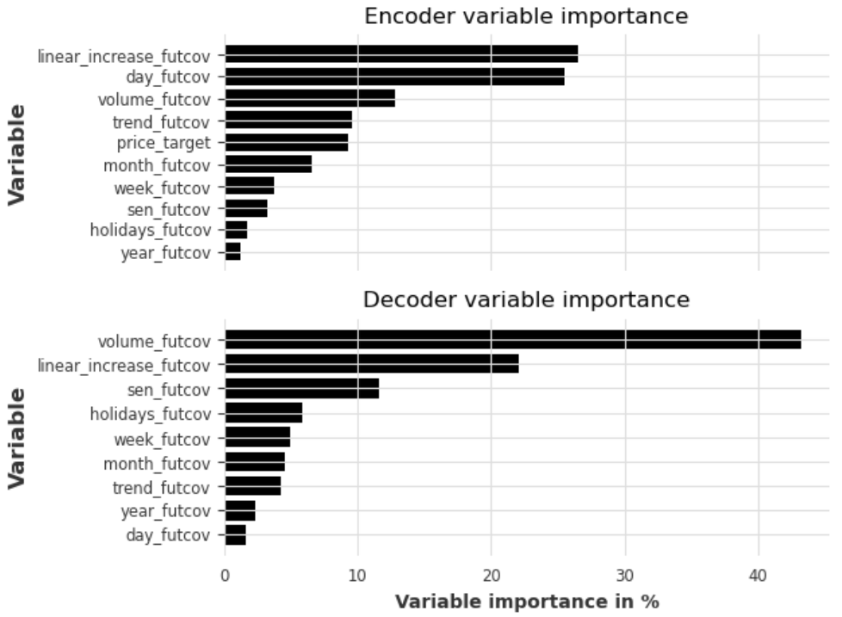
Variable Importance
type | encoder | decoder
year_futcov | 1,20 | 2,30
holidays_futcov | 1,70 | 5,80
sen_futcov | 3,20 | 11,60
week_futcov | 3,70 | 4,90
month_futcov | 6,50 | 4,50
price_target | 9,30 | -
trend_futcov | 9,60 | 4,20
volume_futcov | 12,80 | 43,20
day_futcov | 25,50 | 1,60
linear_increase_futcov | 26,50 | 22,10

Slide 11
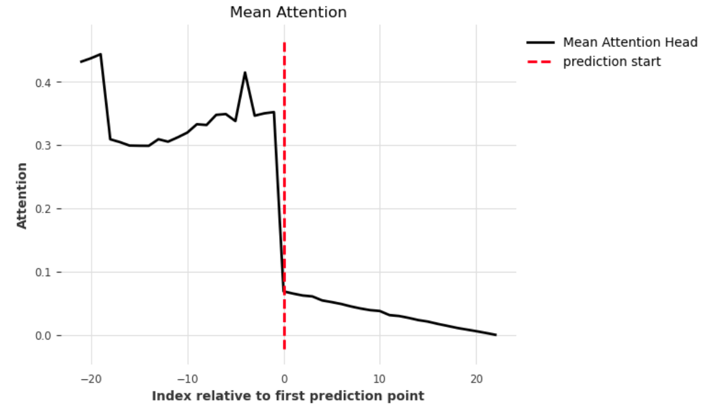
Attention Horizon

